Slide 1
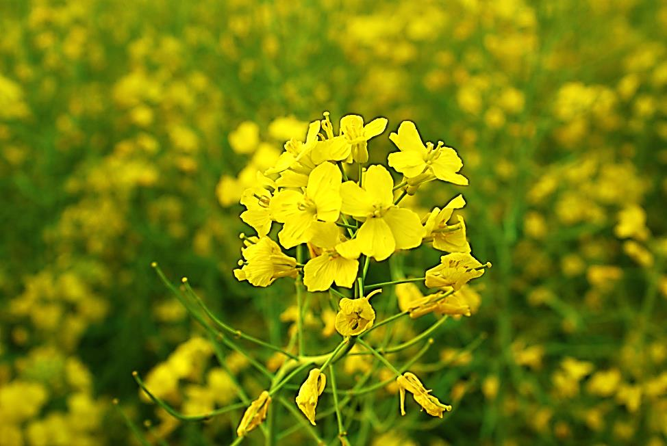
Oilseed Rape Genetic Improvement Network Management Meeting
OREGIN 5 21st February, 2019

Slide 2
WP3.2 Developing pre-breeding lines from exotic B. napus and spring oilseed rape
Target genes have been prioritised as part of WP3.3
OREGIN 5 21st February, 2019

Slide 3
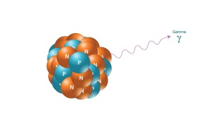
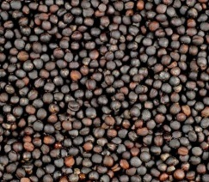
WP3.3 Developing pre-breeding lines from mutagenized populations (JIC, UoY)
Control 250 500 750 1000 1250 1500 1750 2000 Gy
Genome re-sequenced radiation mutagenesis panel
DNA Seq
M1
M1
M2
M2
M3
Gamma irradiation
Selfed plants
~1K selfed M₂ plants per one M₁ individual
DNA extraction
Seed stock
OREGIN 5 21st February, 2019

Slide 4
Genomics-led predictive mutation breeding by using Maplus gamma radiation mutagenized population
Maplus (WOSR, low GSL, high erucic, strong vernalization requirement)
Gamma irradiated at the International Atomic Energy Agency, Austria
~800 M₂ lines
10x genome re-sequencing being conducted by Beijing Genomics Institute
Genome re-sequencing ~ 600 lines completed
OREGIN 5 21st February, 2019

Slide 5
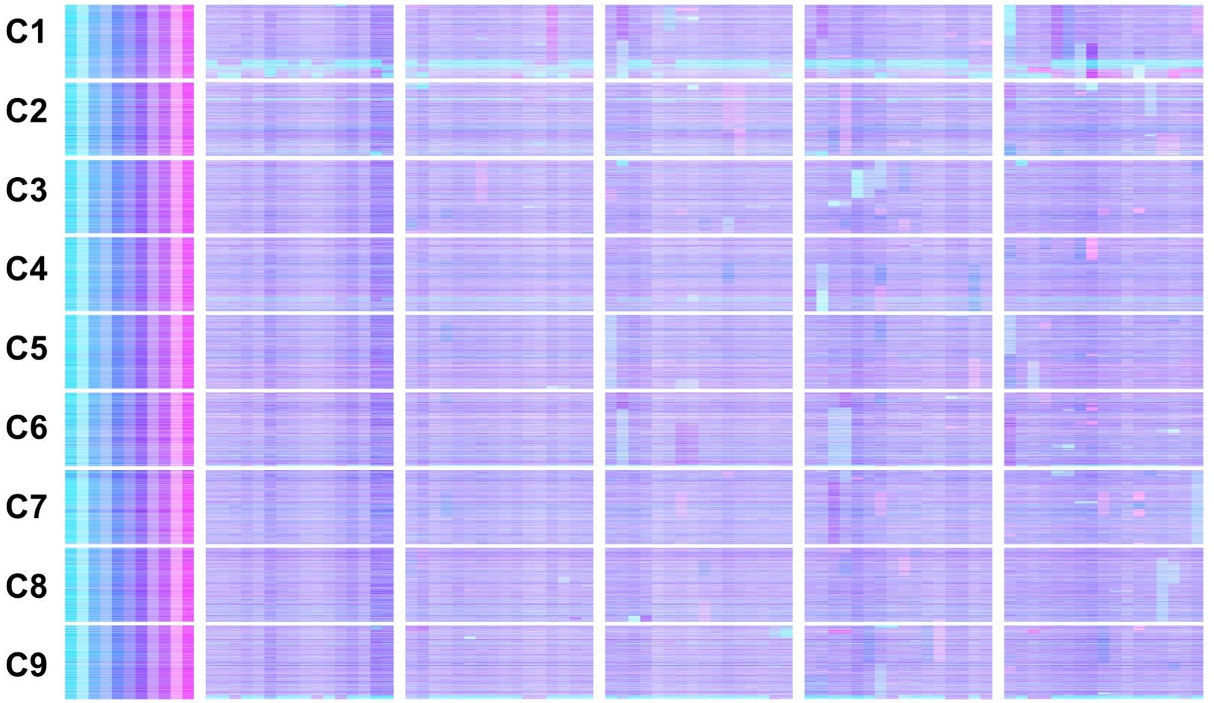
in silico AACCC
TDTP visualization based on mRNAseq data
in silico AAACC
B. oleracea CC
in silico ACCC
in silico AACC
in silico AAAC
in silico ACC
in silico AAC
B. rapa AA
in silico C
in silico A
Untreated
Gamma irradiation M₂ lines (paired siblings)
750 Gy 1500 Gy 1750 Gy 2000 Gy
+ C
Δ C
Δ A
Δ A
Δ CC
+ A
+ A
+ A
Δ A
+ C
Δ C
+ C
+C
Δ A
Δ C
+ A
OREGIN 5 21st February, 2019

Slide 6
GDTP visualization based on DNAseq data – whole panel, chr A5
OREGIN 5 21st February, 2019

Slide 7
1st batch - candidate genes, A. thaliana orthologs of FAE1, FAD2, GTR1, GTR2, eIF, Cyt P450, CER4-like, VTE4
56 different predicted exon frameshift mutations identified in 67 mutation lines for 26 different gene copies. Primers were designed and they amplified the expected gene copy; however, the initially identified mutations were not confirmed by Sanger sequencing. This prompted us to change the in silico mutant selection parameters.
58 structural mutations (duplication/deletion) identified for 26 different gene copies. Mutants confirmed by qPCR.
663 plants grown; self-pollination seeds harvested from 379 plants so far. The rest of the plants are in different developmental stages (some are yet to flower, others did not survive to maturity). 205 confirmed mutants have been crossed with Cabriolet; 180 lines of F1 seeds have been harvested so far
OREGIN 5 21st February, 2019

Slide 8
2nd batch
34 possible candidate genes – 61 mutant lines with increased selection threshold (≥40% variant) were identified in silico. The primer design is completed for all the mutations and we are currently testing the markers. Once the markers are confirmed to be amplifying the desired gene copy, we will start the mutant confirmation by Sanger sequencing.
OREGIN 5 21st February, 2019

Slide 9
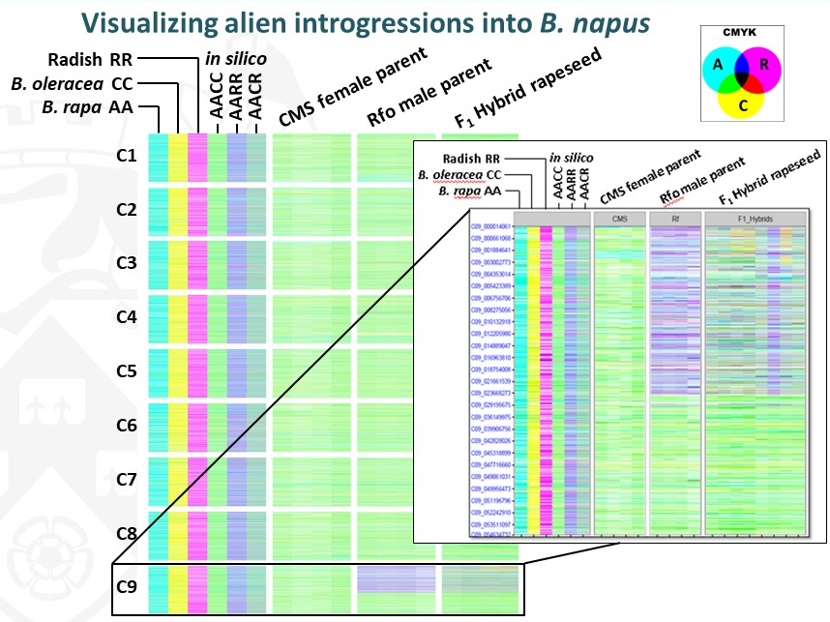
WP3.4 Developing pre-breeding lines from alien introgression material
CMS Ogura-based introgression material (restorer lines) characterized by transcriptome re-sequencing
OREGIN 5 21st February, 2019

Slide 10
WP3.4 Developing pre-breeding lines from alien introgression material
CMS Ogura-based introgression material (restorer lines) characterized by transcriptome re-sequencing
Gamma irradiation used to disrupt the linkage drag by fragmenting the introgressed genome. PCR-based screening for ~700 M2 Ogura restorer plants is under development
OREGIN 5 21st February, 2019

Slide 11
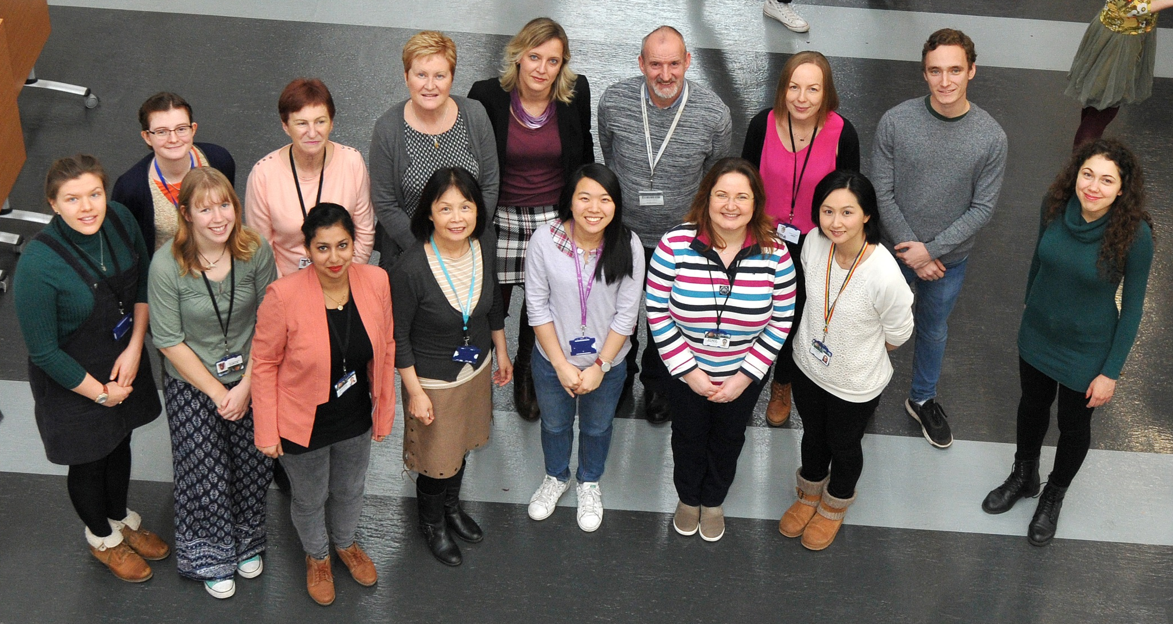
The Bancroft group
Helen Aoife Dorota Julia Lenka Ian Natalia Jamie
Riordan Sweeney Radkiewicz Crawford Havlickova Bancroft Stawniak Huckstep
Alison Harjeevan Lihong Varanya Roxana Zhesi Veronika
Fellgett Kaur Cheng Kittipol Teodor He Yankova
OREGIN 5 21st February, 2019

Slide 13
Wp3b Rapeseed genomic platform
institution | Involved in
RRes | Brassicasterol/campesterol Cyt P450 family 705A (5-8) - AT3G20120.2 Dupl Wax – branched chain/chain lenght CER2 (2) - AT4G24510.1 Dupl CER26 (3-4) - AT4G13840.1 Dupl CER27 (2) - AT3G23840.1 Dupl Total sterols/steryl esters Caffeoyl coenzyme a O-methyltransferase 1 (2) - AT4G34050.1 both Early-responsive to dehydration 3 (6) - AT4G19120.2 both A-adenosylmethionine carrier 1 (2) - AT4G39460.2 both Squalene synthase 1 (7) - AT4G34640.1 both
UoN | Transmembrane transport Sulfate transporter 3;4 (7) - AT3G15990.1 KO Autoinhibited CA2+ -ATPase, ACA8 (5-7) AT5G57110.2 Dupl Root hair Expansin A7 (8) - AT1G12560.1 Dupl Root hair specific 2 (8) - AT1G12950.1 Dupl
UoY | Tocopherols VTE5 (4) - AT5G04490.1 Dupl Sinapine Cyt P40 84A1 (5) - AT4G36220.1 KO
UofC | Xylan, cell wall, starch…
Target genes for testing in the Maplus gamma radiation mutagenized population
institution | Involved in
RRes | Brassicasterol/campesterol Cyt P450 family 710A (6) - AT2G34500.1 KO Wax – branched chain/chain lenght CER4-like (4) - AT4G33790.1 KO Total sterols/steryl esters
UoY | Tocopherols VTE4 (5-6) - AT1G64970.1 KO FAMEs FAE1 (2) - AT4G34520.1 both FAD2 (4) - AT3G12120.2 KO Glucosinolates GTR1/2 (6/8) - AT3G47960/AT5G62680 KO
37 different predicted exon frameshift mutations identified in 39 mutation lines for 23 different gene copies
54 structural mutations (duplication/deletion) identified for 23 different gene copies
>600 plants grown, confirmed mutants will be crossed with Cabriolet (MAS for InDels and big structural mutations is currently under development)
Lenka Havlickova
Notes:
In total 560/592FNT (not including 16 control plants and 32 FNT and including 8Greta’s plants)
2nd batch to be reduced (computational InDel & structural mutation identification finished)
Sinapine biosynthesis

