Slide 1
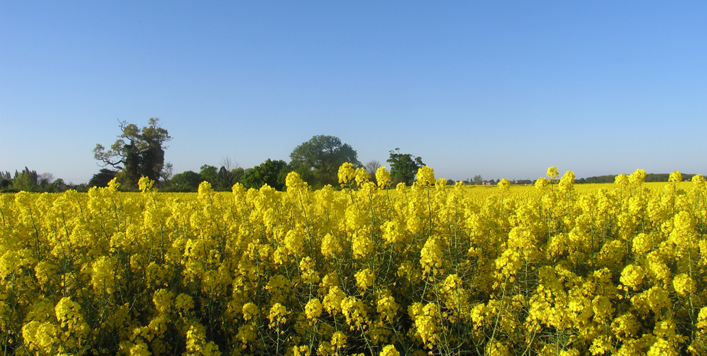
Agricultural crops +Oilseed rape

Slide 2
What are the current threats to the WOSR CROP
Autumn drought
Adult Cabbage stem flea beetle
Excessive autumn winter rainfall
Cabbage stem flea beetle larvae
Excessive storms, hail in particular
False information, media Hype
Loss of chemistry

Slide 3
What does Elsoms breed select
Breed
Oilseed rape
Winter wheat : Elsoms Wheat
Winter and Spring Barley: Elsoms Ackerman
Select and market
Vining peas
Combinable / protein peas/ marrowfats, blues +whites
Linseed, spring and now winter types
Fodder beet
Energy beet

Slide 4
Changing world: Political +climate
Breeding is long term 10+ years from scratch
Introgression of novel genes: conventionally or molecular techniques
Discovery of useful traits: 1 to 20+ years
Climate change is already visible
Breeding, selection is already happening by default
Question is how do we go faster
Politicians make quick changes but breeding often can’t

Slide 5
How can genetics help: Examples, problems
Tolerant lines to CBSF identified: Project with JIC, Rothamsted with most breeders: submitted
Turnip yellows novel virus resistance: John Walsh at Warwick underway here: Breeder involvement
Drought, waterlogging tolerance required: Climate proof!
Insect resistance : pollen beetle, aphids, diamond black moth, white fly all increasingly difficult to kill, or control
Slug tolerance
Pigeon tolerance
Loss of chemistry, new environmental rules
Biocontrol,

Slide 6
Food miles
Carbon Neutral
We still need food
Ever larger populations
What is the answer?

Slide 7
Thank you, any questions

Slide 8
Plant breeding

