Slide 1
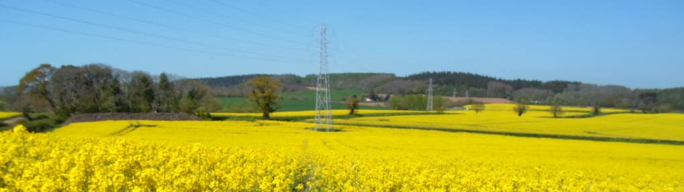




Monitoring the risk of sclerotinia infection in UK oilseed rape
Caroline Young, ADAS
Notes:
Extension approved for 2018 work
Mention consequences of funding cut, if any
Weather based only in 2018, no inoculum – therefore more risk averse, more unnecessary sprays, likely to drive resistance development faster.

Slide 2
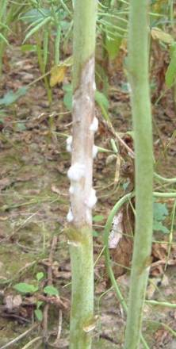
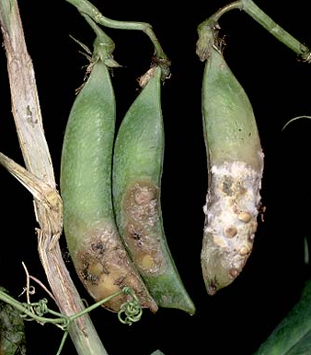
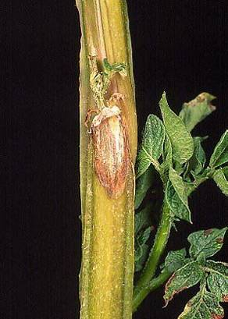
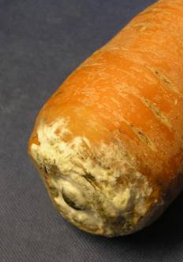
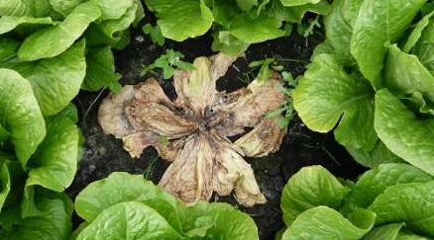
Introduction
Sclerotinia outbreaks are difficult to predict
A range of crops are susceptible
Occasional major outbreaks with 50-80% loss
1-5% incidence every year in affected OSR crops; inoculum build up
Variable duration of flowering in OSR
Infection risk phase > 3 weeks
Good forecasting allows timing of sprays, if needed: 1st and 2nd sprays
Control currently relies on foliar fungicides
Notes:
3 weeks = window of protection.
But flowering usually longer than this.
The problem is that we only know in hindsight which fungicide timing is best
Integrated strategies:
Monitor field history of infection
Lengthen rotations
Don’t include other susceptible crops in the rotation, e.g. peas, potatoes
Manage crop to reduce lodging risk
Avoid high-risk fields

Slide 3
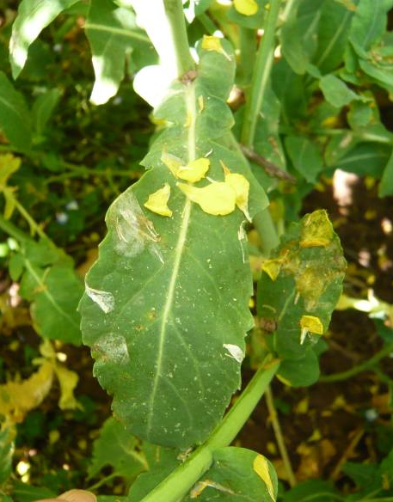
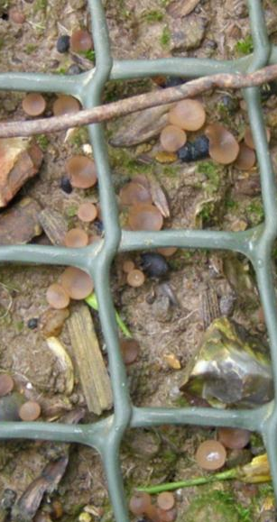
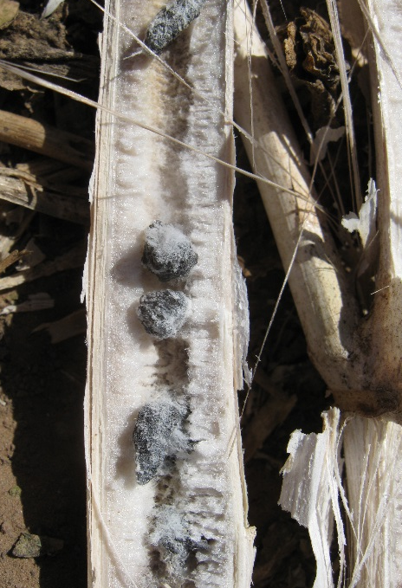
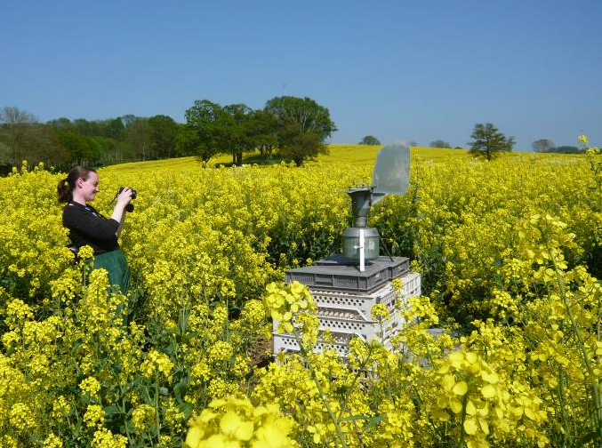
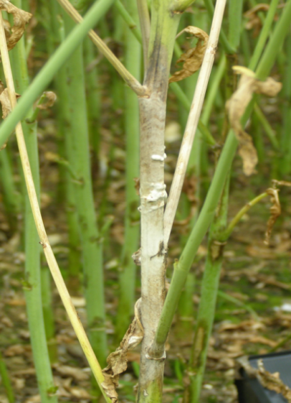
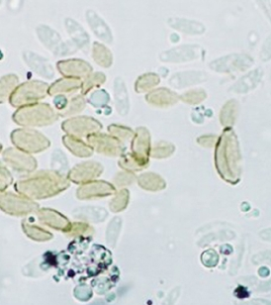
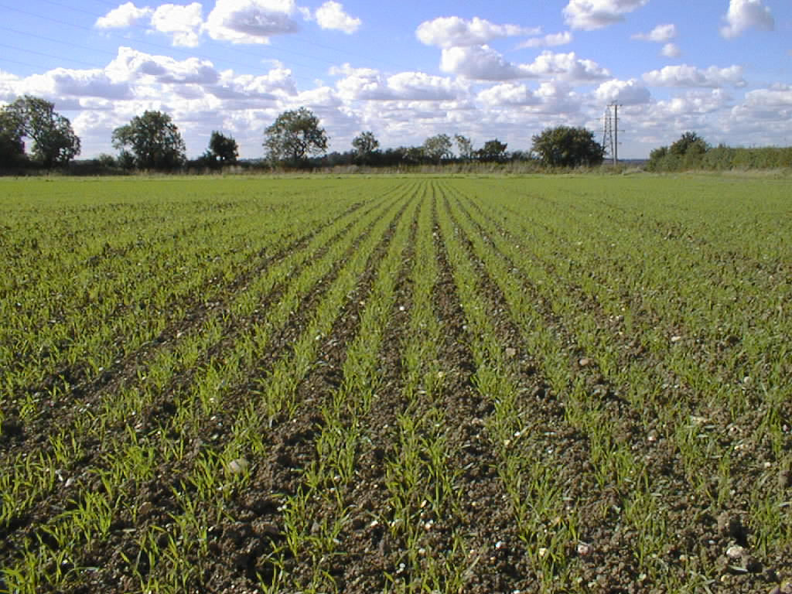
Sclerotinia infection in oilseed rape
Apothecia
Spores
Infection starts
Sclerotia in stems
Stem lesion development

Slide 4
Forecasting sclerotinia in oilseed rape: risk factors and predictions
Risk factors
Crop flowering stage
Germinated sclerotia
*Spore inoculum levels: on petals or in air
*Current weather
Predictions
Date of sclerotial germination
*Forecast weather
Weather-based infection alert
23 continuous hours > 7ºC & RH > 80%
Criteria based on: Koch et al, 2007.
host
disease
pathogen
environment

Slide 5
Inoculum: air sampler measurements, 2011

Slide 6
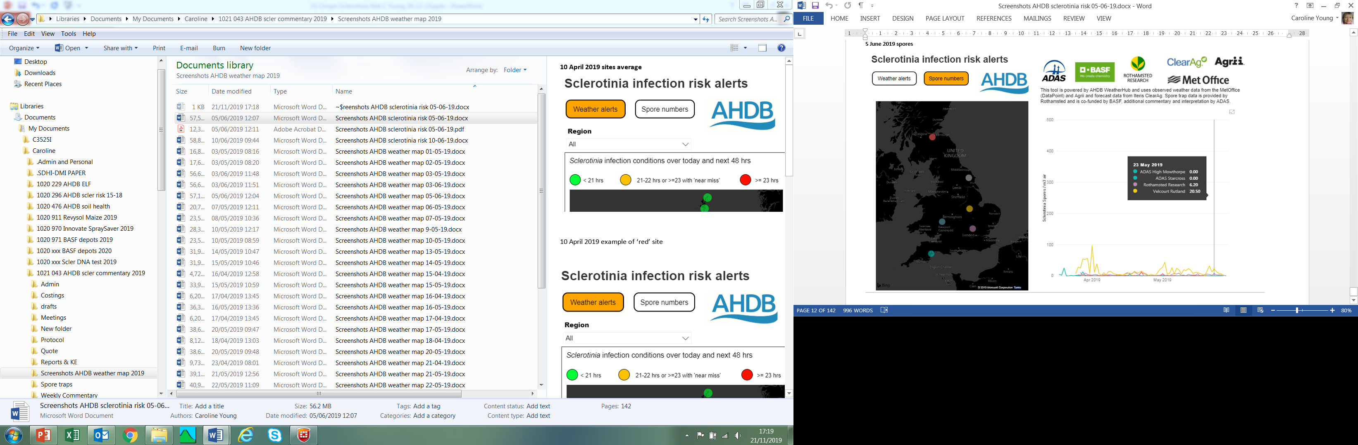
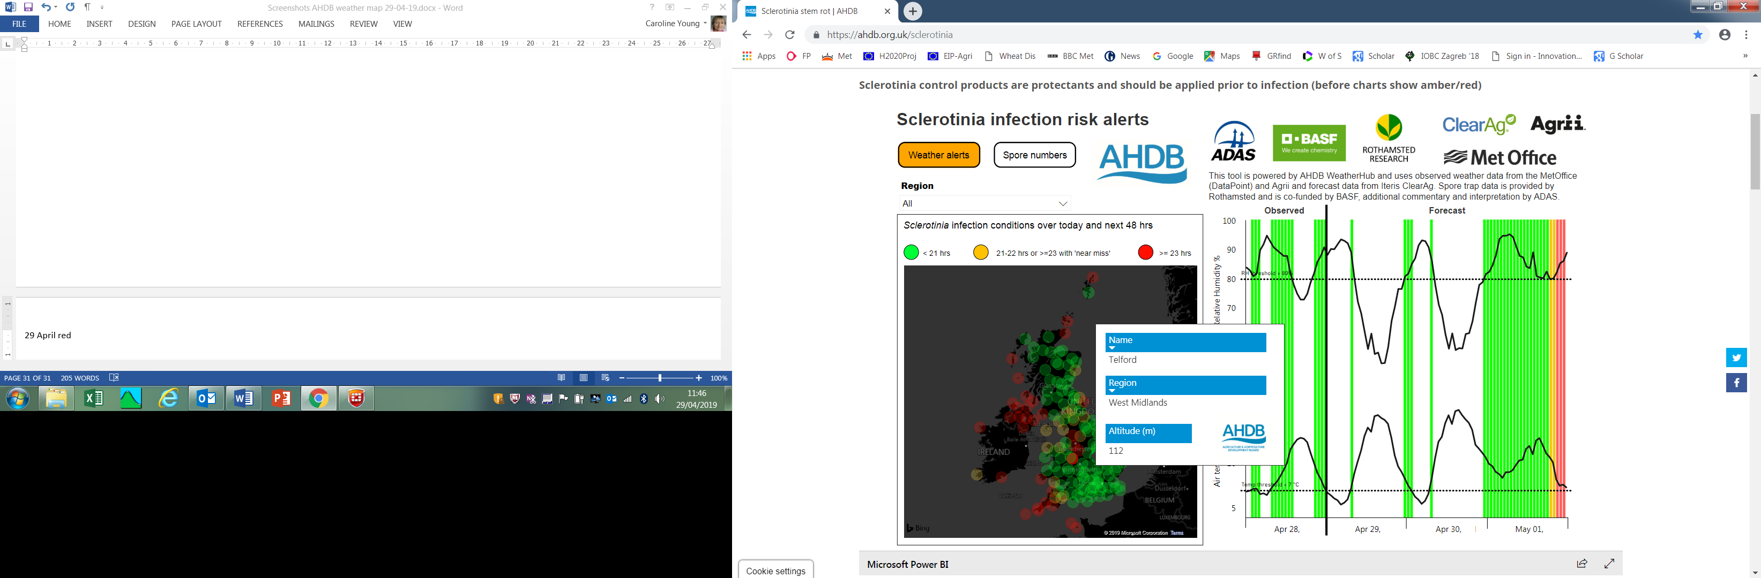
Weather-based risk alerts, AHDB-ADAS 2019
10 April
15 April
19 April
7 May
16 May
23 May
29 May

Slide 7
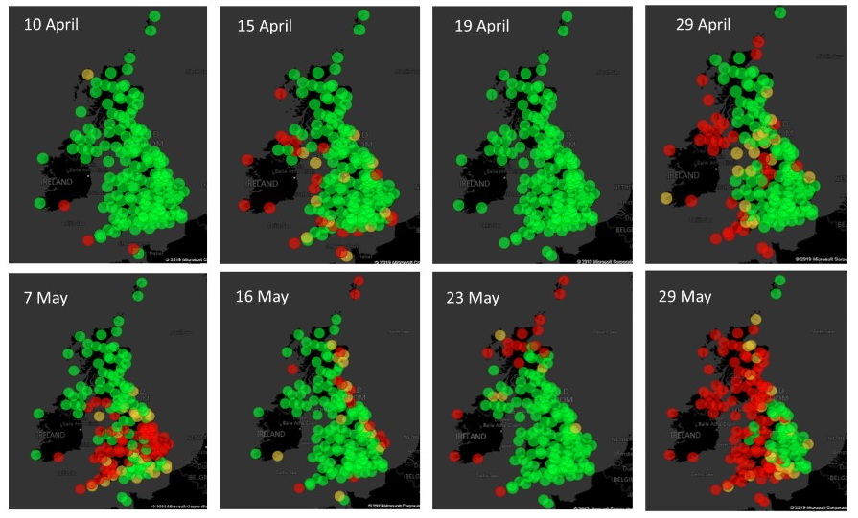
Weather-based risk alerts, AHDB-ADAS 2019
10 April
15 April
19 April
29 April
7 May
16 May
23 May
29 May

Slide 8
Weather-based risk alerts, AHDB-ADAS 2019
10 April
15 April
19 April
7 May
16 May
23 May
29 May

Slide 9
Potential spray saving with alerts, 2010-2018
Timing of fungicide treatment | % of Crops treated | Average sclerotinia incidence %
Untreated | - | 8.4
Early-flower, all (23) | 100 | 3.6
Inoculum alert (18) | 78 | 3.4
Weather alert (18) | 78 | 3.4
Inoculum AND weather alert (17) | 74 | 3.6

Slide 10
Key messages
Risk alerts based on weather and inoculum reduced the number of unnecessary fungicide applications
The alerts are risk averse:
Zero inoculum = no infection
Positive inoculum = infection, but variable levels
Crops at very low risk were correctly predicted
Risk alerts help with fungicide application timing: good control from fungicides applied on or before an alert

Slide 11
Further work
Continue predictions, risk monitoring and evaluation of benefits
Develop automated in-field inoculum testing
Modify scheme for other field crops & diseases
Develop UK OSR varieties resistant to sclerotinia
Promote integrated control strategies
Notes:
Integrated strategies
Monitor field history of infection
Lengthen rotations
Don’t include other susceptible crops in the rotation, e.g. peas, potatoes
Manage crop to reduce lodging risk
Avoid high-risk fields

Slide 12
Thank you
Funding:
ADAS:
Jill Cunningham, Geoff Bailey, Frankie Paine, Julie Smith
Rothamsted Research:
Jon West, Gail Canning
AHDB:
Bastiaan Brak, Catherine Harries

