Slide 1
How Can I Possibly Be Free: A Critique of Neurodeterminism
Raymond Tallis

Slide 2
The Latest News
Neuroscientists have demonstrated that we do not consciously will our seemingly free actions
What we do is determined by the brain and evolution
Our biology is calling the shots

Slide 3
Scope of the Talk (1)
(Incompatibilist) Determinism
Neurodeterminism: General arguments
Neurodeterminism: Empirical support
Critique of empirical data

Slide 4
Scope of the Talk (2)
Revisiting the nature of action
The possibility of being the origin of an action: actions as self-expression
Operating on/with the laws of nature: the virtual outside made of ‘Thatter’
Deflecting the course of nature

Slide 5
Scope of the Talk (1)
(Incompatibilist) Determinism
Neurodeterminism: General arguments
Neurodeterminism: Empirical support
Critique of empirical data

Slide 6
Determinism Tout Court
Our actions are physical events
Every physical event has a cause, which has a cause
The causal ancestry ultimately lies outside our control because it precedes our existence

Slide 7
Determinism Tout Court
Physical events are determined by the laws of (physical) nature which are by definition unbreakable
We cannot deflect the course of events
What we think we have done (caused) was going to happen anyway

Slide 8
Incompatibilist Determinism
The state of the world (including us in it) at any given time is fixed in all of its details by the laws of nature.

Slide 9
Assumptions of Determinism
Actions (including their motivations) are naturally delimited events in the causal nexus
The causal nexus unfolds in accordance with the laws of nature
There is nothing outside of the causal nexus. The world is causally closed.

Slide 10
Scope of the Talk (1)
(Incompatibilist) Determinism
Neurodeterminism: General arguments
Neurodeterminism: Empirical support
Critique of empirical data

Slide 11
Neurodeterminism: Background Assumptions
Our minds are our brains
Our brains are evolved organs
They are designed to maximise the replicative potential of the genome
We are acting out a biological script quite different from the humanist story of ourselves as conscious agents

Slide 12
The Metaphysics/Ontology of Neurodeterminism
There is only one sort of stuff, namely matter – the physical stuff of physics, chemistry and physiology – and the mind is somehow nothing but a physical phenomenon. In short, the mind is the brain… We can (in principle!) account for every mental phenomenon using the same physical principles, laws and raw materials that suffice to explain radioactivity, continental drift, photosynthesis, reproduction, nutrition and growth.³³

Slide 13
Neurodeterminism
The human brain is a machine which alone accounts for all our actions, our most private thoughts, our beliefs…All our actions are products of the activity of our brains. It makes no sense (in scientific terms) to try to distinguish sharply between acts that result from conscious attention and those that result from our reflexes or are caused by disease or damage to the brain.
Colin Blakemore The Mechanics of Mind

Slide 14
The Neuroscience Case Against the Conscious Will
‘The only connexion between willing and acting is that both come from the same unconscious source’.
The Illusion of the Conscious Will Daniel Wegner (Cambridge: MIT Press, 2002)

Slide 15
Scope of the Talk (1)
(Incompatibilist) Determinism
Neurodeterminism: General arguments
Neurodeterminism: Empirical support
Critique of empirical data

Slide 16
General Problems with Neurodeterminism
Methodology of studies, especially of fMRI
The fallibility (indeed contradictions) of the assumption that brain activity is identical with human consciousness
The groundlessness of the assumption that ‘if neuroscience can’t see it, it doesn’t exist’
The confusions between biological origins and cultural consequences

Slide 17
Pitiless Detail

Slide 18
Neurodeterminism: Empirical Support?
Libet, B ‘Unconscious Cerebral Initiative and the Role of Conscious Will in Voluntary Action’ Behavioural and Brain Sciences 1985; 8: 529-566.
‘one of the philosophically most challenging studies.. in modern scientific psychology Haggard, P. and Eimer, M. 1999 ‘On the relation between brain potentials and voluntary movement’ Experimental Brain Research 126: 128-133.

Slide 19
Neurodeterminism: Empirical Support?
Chung Siong Soon, Marcel Brass, Hans-Jochen Heinze, John-Dylan Hayes ‘Unconscious determinants of free decisions in the human brain’ Nature Neuroscience (2008); 11: 543-545.

Slide 20
Implications According to Libet (1)
We do not have free will: the brain ‘decides’ to move, the brain ‘initiates’ movement.
‘If the “act now” process is initiated unconsciously, then the conscious free will is not doing it’
We have ‘free won’t’: we can inhibit movements that are initiated by the brain

Slide 21
Implications According to Libet (2)
We don’t quite initiate voluntary processes; rather we ‘select and control them’, either by permitting the movement that arises out of an unconsciously initiated process or ‘by vetoing progress to actual motor activation’
We ‘rubber stamp’ decisions that have already been made by neural networks.

Slide 22
Scope of the Talk (1)
Determinism
Neurodeterminism: General arguments
Neurodeterminism: Empirical support
Critique of empirical data

Slide 23
Challenging this Interpretation
Restore this simple action to its (very complex) context
Movement a minute part of a large action – taking part in Dr Libet’s experiment
Part of a network of actions – beginning with getting up in the morning
Decision to flex the wrist took place minutes, hours, weeks before the movement

Slide 24
Tim Crane’s Critique
Our actions are interconnected, as are intentions, decisions and plans.
Our actions unfold without there being explicit decisions – except broad brush ones – at every node.

Slide 25
Scope of the Talk (2)
Revisiting the nature of action
The possibility of being the origin of an action: actions as self-expression
Operating on/with the laws of nature: the virtual outside
Deflecting the course of nature

Slide 26
How to Make Actions Seem Unfree
Strip away their context: the self from which they originate, the nexus of meanings that is the world to which they are addressed
Make an action a succession of twitches
Remove the nested goals
Burn off the self-world
Treat them as ‘effects’

Slide 27
Action are Not Effects
The notion of material cause not applicable to them
Swathes of the self (know-that, know-how, reasons, motives) are not causes
Actions are expressive of myself
They require a synthesis of conditions, forces etc that only I can effect in the context of a forward-looking conscious intention

Slide 28
Scope of the Talk (2)
Revisiting the nature of action
The possibility of being the origin of an action: actions as self-expression
Operating on/with the laws of nature: the virtual outside
Deflecting the course of nature

Slide 29
Am I the Origin of My Actions?
Am I justified in saying ‘The buck starts here’? How can a material object in a material world be a point of origin of events?
If my actions are an expression of myself, am I free if I did not cause or bring myself about?

Slide 30
Am I the Origin of My Actions?
Am I justified in saying ‘The buck starts here’? How can a material object in a material world be a point of origin of events?
If my actions are an expression of myself, am I free if I did not cause or bring myself about?

Slide 31
The mystery of intentionality
Light as Cause
Intentionalityl of gaze
Neural activity
Identity
Perception
Object
“Object”

Slide 32
Metaphysical Limitations of the Neurophysiology of Perception
The inward causal chain explains how the light gets into my brain but not how this results in a gaze that looks out.

Slide 33
The Bounce-Back of Intentionality
Marks the point at which perceptions are received
Without ‘bounce-back’ there would be no demarcation between input and output : the organism would not be a ‘centre
It establishes a point of origin, a centre in a material world which has no ‘here’

Slide 34
Intentionality
Tears the hitherto seamless fabric of a causally closed material world
The seed out of which grows first-person being (unique to humans)
A trillion cognitive handshakes
The human world – the semiosphere

Slide 35
Actions as Expressive of My Self
Make sense – and indeed are made possible – only with respect to a personal past and future
The self has temporal depth
Virtual causality (Scruton)

Slide 36
Overlooking Our Role in Shaping Ourselves
Catching a ball
Learning to juggle

Slide 37
Plasticity
Of the brain
Of the body
Of the self
Of the world

Slide 38
Am I the Origin of My Actions?
Am I justified in saying ‘The buck starts here’? How can a material object in a material world be a point of origin of events?
If my actions are an expression of myself, am I free if I did not cause or bring myself about?

Slide 39
Galen Strawson’s Argument
Nothing can be the cause of itself.
In order to be truly morally responsible for one’s actions, one would have to be the cause of one’s self.
Therefore nothing (and hence no-one) can be truly morally responsible.

Slide 40
Against Strawson
We have described sufficient causa sui to satisfy the demand that we should be the origin of our actions
This appropriation of part of the world as ourselves begins with the Existential Intuition
We are supported in this by the human world of pooled transcendence
The idea that freedom requires no ‘starter pack’ of the given empties freedom

Slide 41
Scope of the Talk (2)
Revisiting the nature of action
The possibility of being the origin of an action: actions as self-expression
Operating on/with the laws of nature: the virtual outside
Deflecting the course of nature

Slide 42
John Stuart Mill to the Rescue

Slide 43
JS Mill on Freedom
Though we cannot emancipate ourselves from the laws of nature as a whole, we can escape from any particular law of nature if we are able to withdraw ourselves from the circumstances in which it acts. Though we can do nothing except through laws of nature, we can use one law to counteract another.

Slide 44
The Possibility of Freedom
We utilise the laws of nature
We position ourselves to do so
We assume a position from a virtual outside-of-nature
The human sphere: a public realm; the semiosphere; the technosphere

Slide 45
On the Slide
Mummy is persuaded by me and finds time to take me to the park
We follow a route to get there
We climb to the top of the slide which has been built for this purpose
We yield to gravity – by appointment
‘We obey nature in order to command her’ F Bacon
We make handles out of material causes

Slide 46
‘Obey [ing]nature so as to command her’ Francis Bacon
Go with the grain of the natural world
Step back into human world
Material causes as handles/levers
Science-based technology originating in the community of minds

Slide 47
Technology
Possible because we approach nature from that outside whose seed is the intentionality of our conscious awareness.
This outside is built up as an expanding Space of Possibility.
A first-person plural reality, constructed through the joined endeavours of the human race, and expanded since the first hominids first awoke to their own existence.

Slide 48
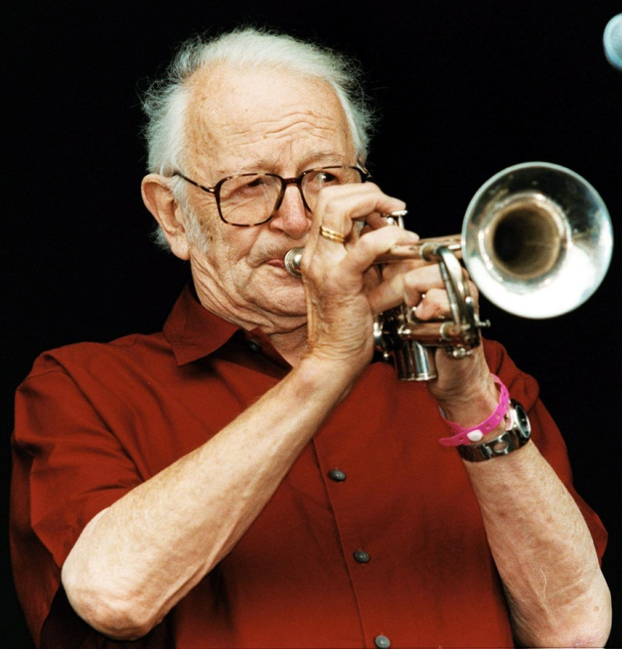
Humphrey Lyttleton
‘I hear the tortoise of time explode in the micro-wave of eternity’

Slide 49
The Characteristics of a Free Act
It is expressive of what I am
It originates from within me
It deflects the course of events

Slide 50
Scope of the Talk (2)
Revisiting the nature of action
The possibility of being the origin of an action: actions as self-expression
Operating on/with the laws of nature: the virtual outside
Deflecting the course of nature

Slide 51
Evidence of Freedom: Si monumentum requiris, circumspice
The artifactscapes of cities
The human institutions to which we relate for so much of our lives, and t
The extra-natural social facts and preoccupations that fill our waking hours,
We operate within a space outside of the material world construed according to the laws of physics.

Slide 52
Evidence of Freedom: Si monumentum requiris, circumspice
From pointing, through artifacts and spoken, and ultimately written, language, we get ever greater purchase on the natural world from an ever greater outside built up by thousands of generations comprised each at first of thousands, then of millions and ultimately of billions, of people.

Slide 53
The ‘Illusion’ of Freedom
‘All theory is against freedom of the will; all experience is for it’.
‘We know our will is free and there’s an end on’t’
Dr Johnson

Slide 54
The Mystery of the ‘Illusion’ of Freedom
Why should one section of the infinite causal nexus of the universe decide, apparently without any foundation, that it is itself a point of origin of certain events - actions - that are not simply part of an endless chain of causes whose ancestry ultimately lies in the Big Bang?
An odd idea for a causal net, or a bit of it, to entertain.

Slide 55
The Mystery of the ‘Illusion’ of Freedom Solved
The illusion of free will is deeply ingrained precisely because it prevents us from falling into a suicidally fatalistic state of mind- it is one of the brain’s most powerful aids to survival….By creating the illusion that there is a self-determining ‘I’ in each of us, it causes us to punish those who appear to behave badly, even when punishment clearly has no practical benefit. Rita Carter

Slide 56
The Solution Affirms the Reality of Freedom
If the illusion of free will does deflect the course of events – and hence is self-fulfilling.
Hence it is not an illusion.

Slide 57
What I Hope I Have Demonstrated
We are capable of free actions, in the sense of events that are expressive of us, originate with us, and deflect the course of things;
They do not require us to break the laws of material nature.
Neuroscience adds nothing to the flawed case for believing that free will is an illusion.
Neurodeterminism works within the same assumptions as determinism period but it usefully highlights the flaws of the latter.

