Slide 1
New seed applied strategies to enhance establishment
Stephen Beal
Blue Shed Consulting Ltd
November 2019

Slide 2

Introduction
Stephen Beal spent over 25 years working in the Agrochemical industry before setting up his own independent consulting company in 2017 called Blue Shed Consulting Ltd. As a consultant, his knowledge and expertise in business development and adding value for the seed channel has enabled him to help 3 top 6 global seed treatment companies with strategic initiatives and many smaller companies looking to advance their technology into seed in a range of crops and geographies.
Industry experience
Global Marketing Lead Crop Establishment and Seed Treatment – Arysta
European Commercial Lead Seed Treatment – Arysta/Chemtura
NW Europe Portfolio Manager Seed Treatment and Diverse Field Crops – Syngenta
Global, Regional and UK Product Manager Seed Treatment – Monsanto (UK and US)
UK Business Lead Seed Treatments – BASF
Various technical, commercial, sales and marketing roles in the UK for Rhone-Poulenc, Aventis and Bayer

Slide 3
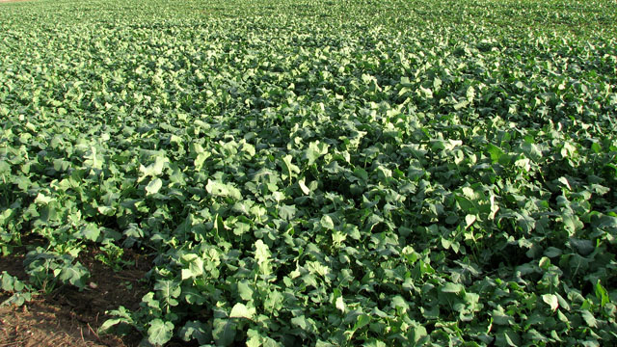
Establishment is key to a successful OSR crop
Key risks factors affecting optimum early establishment
  Poor seed quality
  Soil-borne diseases
  Bird attack
  CSFB
  Weather conditions
  Soil nutrition and preparation

Slide 4

UK oilseed rape seed treatments
Background
Early treatments used against pests and diseases
Thiram, prochloraz, Gamma HCH
More targeted and less hazardous insecticides introduced late-90’s
Neonic restrictions – 2014 (OSR)
Prochloraz based fungicide withdrawn 2018
Total ban on neonics - 2018
Thiram non-inclusion on Ann I from 2019
The OSR crop is left with few currently approved products as seed treatments to control yield limiting pests and diseases

Slide 5
Impact of loss of actives
Reduction in the area of the crop grown since 2014
Driven mainly by flea beetle severe risk areas
But also by concerns over loss of key herbicides to control blackgrass
Growers ‘tempted’ to use own saved seed and drill at higher seed rates
Reduced focus from active discoverers and developers in OSR (seen as minor and in EU difficult to get approval)
Reduced value to the seed channel from lost margin

Slide 6
What is being used?
More focus on products approved as ‘fertilizers’ or plant stimulants
Phosphites (e.g. Take-off)
Micro nutrients (e.g. Radiate)
Growth stimulants
Microbes (Integral Pro)
Plant extracts (Sylas)
All claim benefits of germination, early vigour and establishment

Slide 7
Some new actives/products are scheduled
Scenic Gold
Fungicide - fluopicolide + fluoxastrobin
Claim – Phoma, Alternaria, downy mildew, damping off
Approval – anticipated UK 2020 (already granted in Cz & Lith)
Lumiposa
Insecticide - cyantraniliprole
Claim – CS flea beetle, cabbage root-fly, turnip sawfly. Crucially not aphids
Approval – anticipated UK 2020/1 (already granted in Pol, Ger, Hu)
Into the 2020’s other new MoA’s and active families are under investigation.
SDHI’s, novel insecticides, novel fungicides
Registrability, particularly insecticides on bee-attractive crops is unclear
OSR crop is unlikely to be a driver crop for new actives

Slide 8
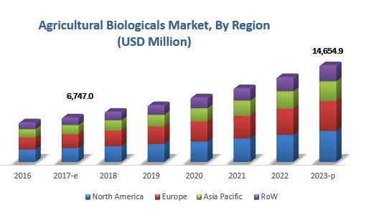
Biologicals are the answer………………. right?

Slide 9
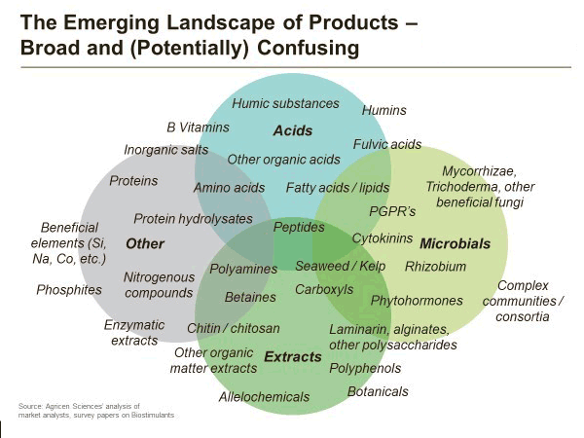
‘Bio’ confusion
The predicted growth in’non’-chemical crop protection agents is significant.
  Fastest growth area in the industry
Some confusing descriptions are being used
  Bio-control
  Bio-stimulation
Regulations are currently less strict than for PPP but this is under review
There is political drive to encourage the use of ‘natural’ alternatives to PPP
Demonstrating benefits consistently and gaining market acceptance and trust is key

Slide 10
Growing challenges/opportunities to new technology
Legislation
Further restrictions on existing actives
Tighter regulatory rules for new actives
ECHA proposal on primary microplastic reductions – impact on use of polymers in PPP
Macro environment
Climate change
Global demand for plant-based oils/food

Slide 11
Meeting the future establishment needs of the OSR crop
In-seed technology
On-seed technology
Processing and enhancing
Genetics
Traits
Chemical PPP
Biological control
Bio-stimulants
Colours, polymers
Physical control
Pelleting
Maximising the potential of seed to the grower and end-user will require closer linkages between the 3 channels in the seed production process.
Losing the ability to control a disease with one method may create an opportunity with another.
The end result is a product that meets the growers and end-users needs.
The technology developed to provide control of key pests and diseases may become interchangeable

Slide 12
Closing thoughts
The continued availability of ‘1107’ approved products within the EU in OSR will remain challenging
Will UK continue to follow EU approval process post Brexit?
The use of micro-nutrient, biological and plant based stimulants is likely to increase
The development of microbial control agents is a rapidly growing area but challenges of consistency, control mechanism and scalability need to be addressed
To develop solutions to enable valuable seed to reach its’ potential requires industry-wide collaboration

