Slide 1
Hertfordshire: a history of social justice
Dr Katrina Navickas
Reader in History, k.navickas@herts.ac.uk
http://www.herts.ac.uk/heritage-hub/centre-for-regional-and-local-history-research

Slide 2
‘a county of small towns’

Slide 3
A county of utopian planning

Slide 4
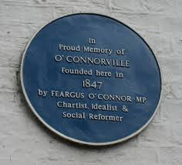
O’Connorville, Heronsgate, Rickmansworth, west Hertfordshire
Map of O’Connorville, 1847,
British Library

Slide 5
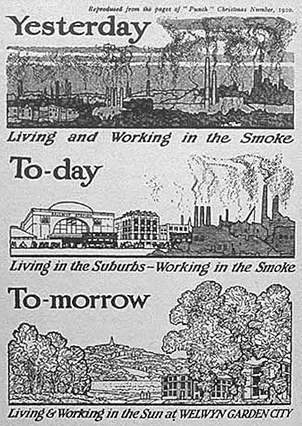
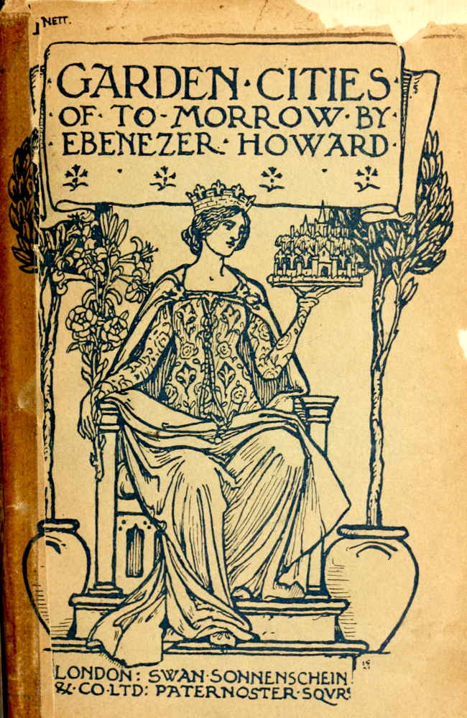
Ebenezer Howard and the first garden cities

Slide 6
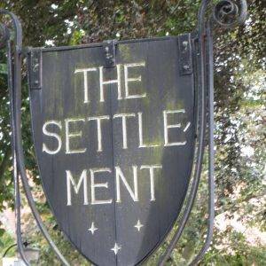
The reputation of Letchworth Garden City
John Betjeman, Group Life: Letchworth
“Sympathy is stencilling, Her decorative leatherwork, Wilfred’s learning a folk-tune for The Morris Dancers’ band.”
George Orwell, ‘The Road to Wigan Pier’ (1937):
“Letchworth attracts… every fruit juice drinker, nudist, sandal wearer, sex-maniac, Quaker, nature cure quack, pacifist and feminist in England”.
http://urbanrambles.org/walks/uk/england/east-of-england/letchworth-garden-city-184

Slide 7
New Towns Committee (1945-6)
“promotion of New Towns in furtherance of a policy of planned decentralisation from congested urban areas … such Towns should be established and developed as self-contained and balanced communities for work and living.”
‘Charley in New Town’, Central Office of Information for Ministry of Town and Country Planning, 1948

Slide 8
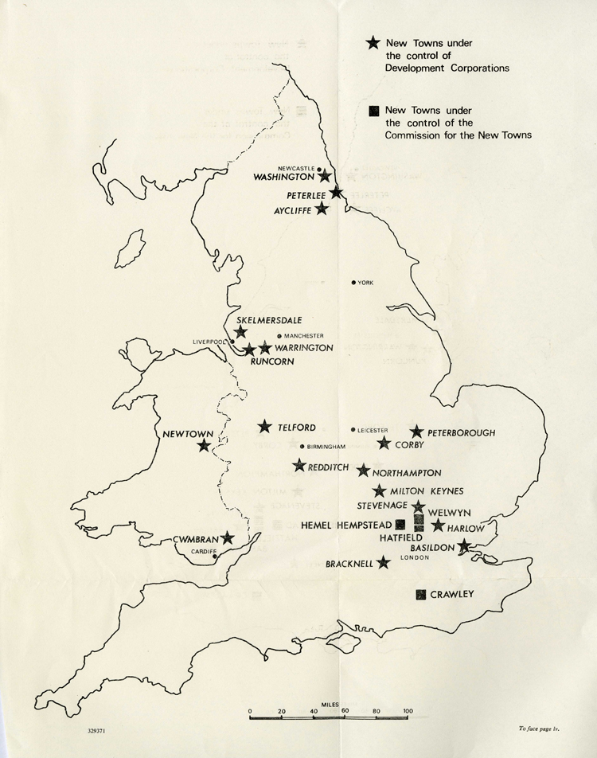
New town utopias
The National Archives, Map produced for the Commission for New Towns, 1969 (FJ 3/77)

Slide 9
A county of activism and resistance

Slide 10
The ‘Battle of Berkhamsted Common’, 1866
https://www.nationaltrust.org.uk/ashridge-estate/whats-on/the-battle-of-berkhamsted-common

Slide 11
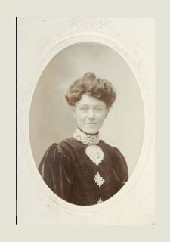
The suffrage movement and Hertfordshire
Lady Constance Lytton of Knebworth House, of the Women’s Social and Political Union, imprisoned 4 times for suffrage activism
Elizabeth Impey, of Hitchin, secretary of the Hertfordshire branch of WSPU
Annie Swan, of Hertford, set up arrangements for receiving Belgian refugees in East Hertfordshire at the start of WWI, later set up a community kitchen to provide affordable meals, and went on a mission to visit President Hoover in the US, requesting food aid for the UK.

Slide 12
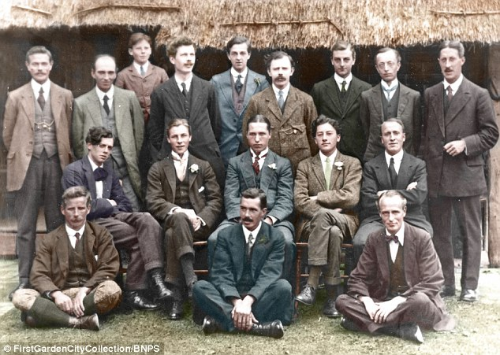
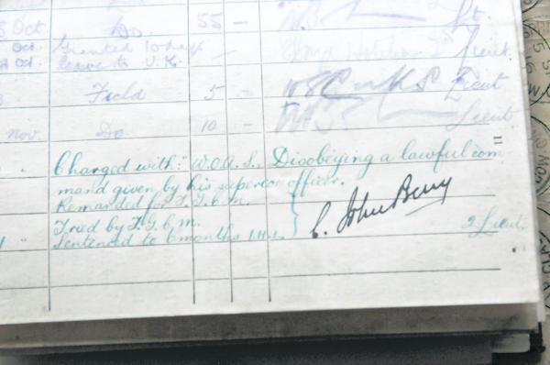
Conscientious objectors in Watford, Letchworth and Hertford
Letchworth conscientious objectors
Watford court martial book,
https://www.watfordobserver.co.uk/news/11376466.Remembering_Watford_s_Conscientious_Objectors_during_World_War_One/#gallery1

Slide 13
‘The Letchworth 18’ Hertfordshire Mercury 1 April 1916
Next came a batch of 18 conscientious objectors from Letchworth. The court was crowded with their supporters, including a number of women and various “peculiar” people, a type familiar to those who know the Garden City. Long-haired, lantern-jawed, hatless, ascetic-looking people for the most part, they were represented by Mr Rafferty, a barrister-at-law.
The first of them to be heard was Matthew Owen Bevan. He said that he could not do anything that would assist in the prolongation of the war, not even tending the wounded. At the beginning of the war, when his position was uncertain and he had not been brought face to face with the real facts, he felt that he ought to do something, and joined the Friends Ambulance Corps at York.
…After a time, however, he found that he was short-sighted and wrong, and that he was definitely assisting in the war by healing men and making them fit to fight again, the very thing that he hated. Then he came to the conclusion that he could have no lot or part in this business.
http://www.hertsmemories.org.uk/content/herts-history/topics/world_war_one/conscientious_objectors/the_letchworth_eighteen

